Slide 1

PACKAGES IN JAVA

Slide 2
Introduction to Packages
The main feature of OOP is its ability to support the reuse of code:
Extending the classes (via inheritance)
Extending interfaces
The features in basic form limited to reusing the classes within a program.
What if we need to use classes from other programs without physically copying them into the program under development ?
In Java, this is achieved by using what is known as “packages”, a concept similar to “class libraries” in other languages.

Slide 3
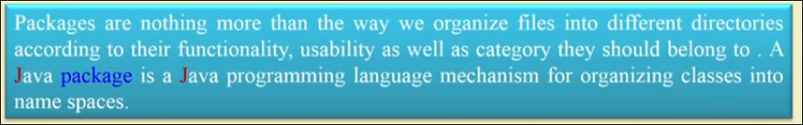
What is Package?
Packages are Java’s way of grouping a number of related classes and/or interfaces together into a single unit.
A Package is a container for the classes that are used t keep the class name space compartmentalized.
Example: You can contain all classes related to sorting programs in your own package.

Slide 4
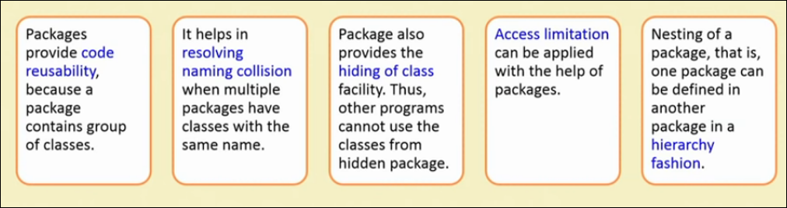
Why Packages?

Slide 5
Types of Packages
Built in / System packages: Java has number of packages called API bundled with the JDK.
User defined packages: In addition to the API, user can maintain their own packages.

Slide 6
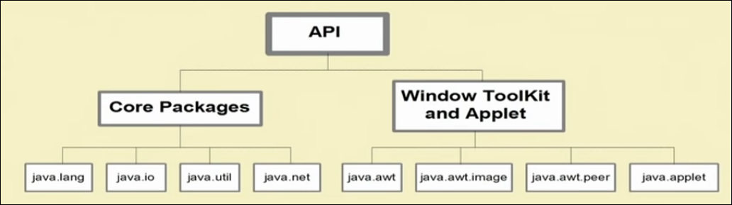
Built in Packages

Slide 7
Java Foundation Packages
Java provides a large number of classes groped into different packages based on their functionality.
The six foundation Java packages are:
java.lang
Contains classes for primitive types, strings, math functions, threads, and exception
java.util
Contains classes such as vectors, hash tables, date etc.
java.io
Stream classes for I/O
java.awt
Classes for implementing GUI – windows, buttons, menus etc.
java.net
Classes for networking
java.applet
Classes for creating and implementing applets

Slide 8
Using API Packages
A package is a collection of classes and each class is a collection of members and methods.
Any class as well as any member and method in a package are accessible from a JAVA program.
This can be achieved by import statement.
With fully qualified class name. e.g. java.util.Scanner;
There are two ways of using import statement
With default(.*) qualification.
e.g. java.util.*;

Slide 9
User defined packages
User can maintain their own packages.
Java uses file system directories to store packages.
The package keyword is used for creating new package.
Syntax: package mypack; public class MyPackageClass
{
------------ }
Here, mypack is the name of package which contains MyPackageClass class.
Will be saved as
MyPackageClass.java

Slide 10
Points to remember while using packages
Package name should be all lowercase letters
Use package statement at the beginning of the package file.
Define the class that is to be put in the package and declare it as public.
Create a sub directory under the working directory with same name as the package name.
Store the file with same name as classname.java in the subdirectory created.
Store the compiled version i.e. .class file into the same sub directory.

Slide 11
Program for creating package
package mypack;
class MyPackageClass
{
public static void main(String args[])
{
System.out.println("my package");
}
}

Slide 12
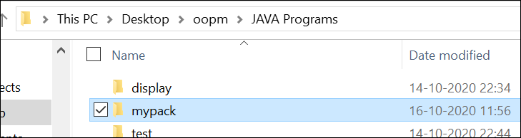
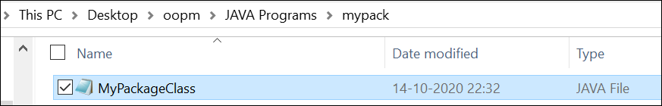
Steps for execution of package
1. Create subdirectory
2. Save .java file in the subdirectory

Slide 13
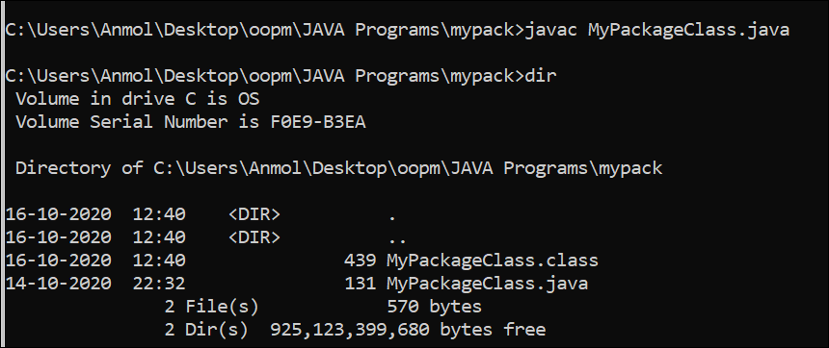
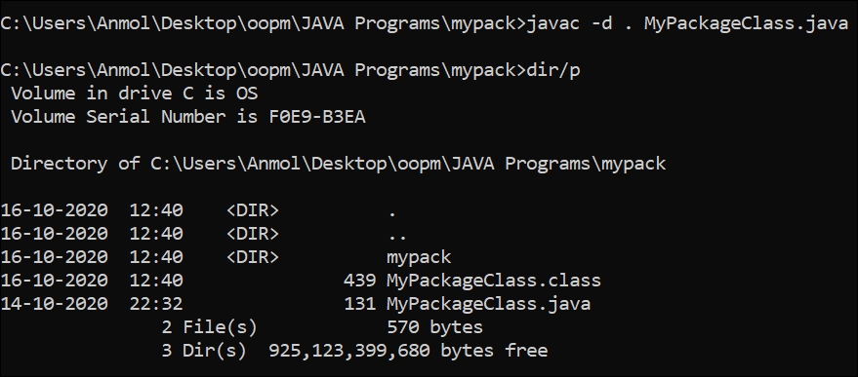
Steps for execution of package
3. Compile .java file and save it in the same subdirectory
4. Provide path for package file to be saved
Notes:
-d specifies the destination for package file to be saved
. for same directory where in we have java and class files

Slide 14
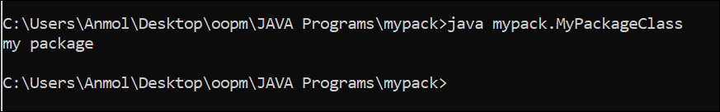
Steps for execution of package
5. Execute class file

Slide 15
Package design guidelines
Only closed related classes should belong to the same package.
Classes that change together should belong to the same package.
Classes that are not reused together should not belong to the same package.
We can not put two or more public classes together in a .java file, else there will be an ambiguity in naming .java file.

Slide 16
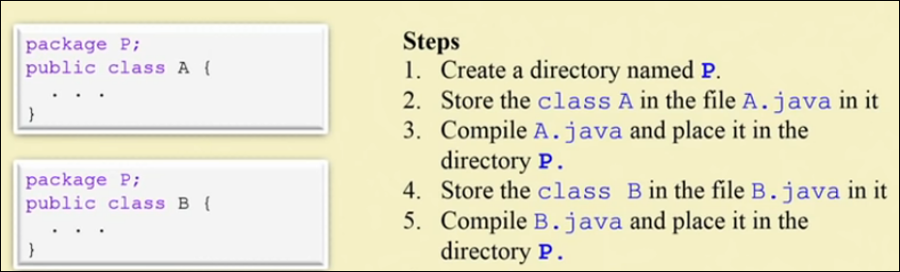
How package contains multiple classes?
import p.*; (Will import all classes from the package p)

Slide 17
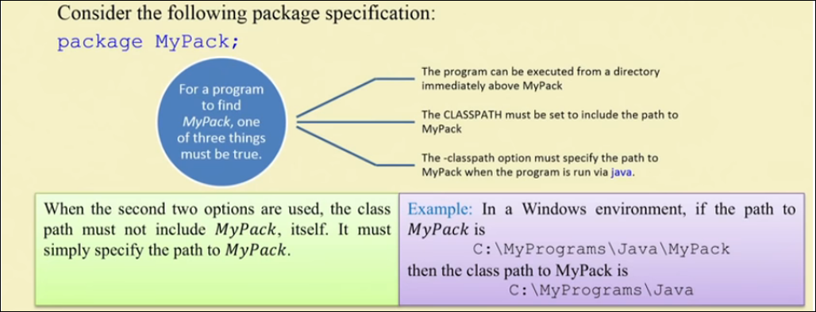
Finding packages and classpath

Slide 18
package samplepack;
class Balance
{
String name;
double bal;
Balance(String n, double b)
{
name=n;
bal=b;
}
void show()
{
if(bal<0)
{
System.out.println(" insufficient balance");
}
else
System.out.println(name + " " +bal);
}
}
class AccountBalance
{
public static void main(String args[])
{
Balance current=new Balance("dimple", 1000.00);
current.show();
}
}

Slide 19
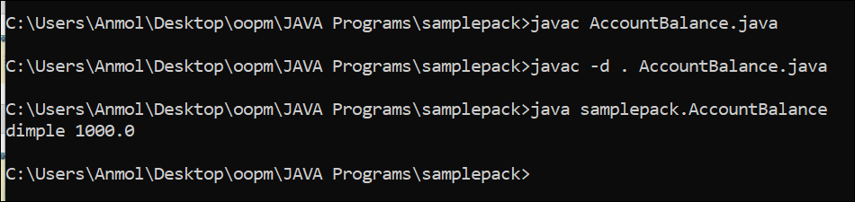

Slide 20
Program for using user defined package
package mypackage;
public class ClassA {
// class body
public void display()
{
System.out.println("Hello, I am ClassA");
}
}
class ClassB {
// class body
}
Create subdirectory as ‘mypackage’ and save above program as ClassA.java

Slide 21
Program for using user defined package
import mypackage.ClassA;
public class ClassX
{
public static void main(String args[])
{
ClassA objA = new ClassA();
objA.display();
}
}
Save above program as ClassX.java in working directory i.e. one directory above this subdirectory.

Slide 22
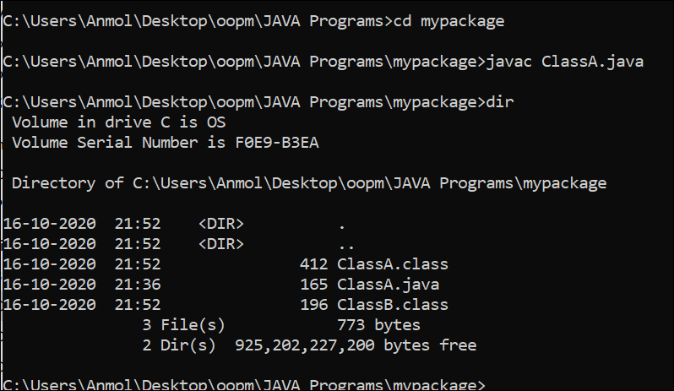
Compiling and Running

Slide 23
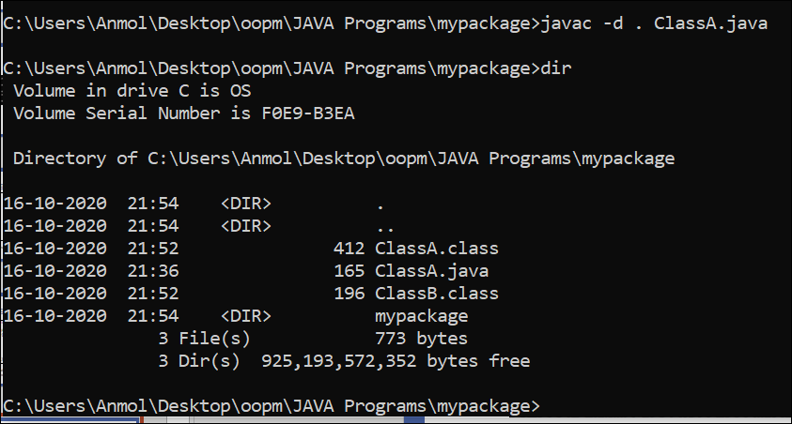
Compiling and Running

Slide 24
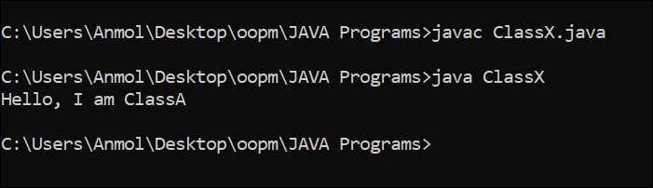
Compiling and Running
Notes:
Note: It does not include code of ClassA into ClassX
When the program ClassX is run, java loader looks for ClassA.class file in a package called “mypackage” and loads it.

Slide 25
Program for adding more classes in package
package mypackage;
public class ClassA {
// class body
public void display()
{
System.out.println("Hello, I am ClassA");
}
}
class ClassB {
// class body
}
package mypackage;
public class ClassC {
public void display()
{
System.out.println("Hello, I am ClassC");
}
}
Create subdirectory as ‘mypackage’ and save above program as ClassA.java and ClassC.java

Slide 26
Program for using user defined package
import mypackage.*;
public class ClassX
{
public static void main(String args[])
{
ClassA objA = new ClassA();
objA.display();
ClassC objC = new ClassC();
objC.display();
}
}
Save above program as ClassX.java in working directory i.e. one directory above this subdirectory.

Slide 27
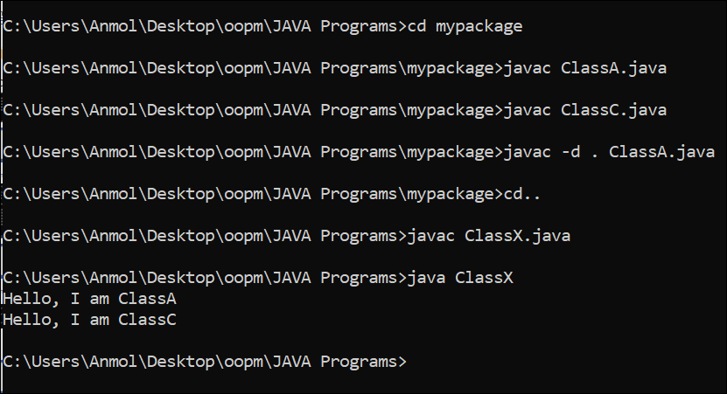
Compiling and Running

Slide 28
Protection and Packages
All classes (or interfaces) accessible to all others in the same package.
Class declared public in one package is accessible within another.
Members of a class are accessible from a different class, as long as they are not private
protected members of a class in a package are accessible to subclasses in a different package

Slide 29
Visibility
Public keyword applied to a class, makes it available/visible everywhere. Applied to a method or variable, completely visible.
Private fields or methods for a class only visible within that class. Private members are not visible within subclasses, and are not inherited.
Protected members of a class are visible within the class, subclasses and also within all classes that are in the same package as that class.

Slide 30
Visibility Modifiers

Slide 31
Adding a Class to a Package
Consider an existing package that contains a class called “Teacher”:
This class is stored in “Teacher.java” file within a directory called “pack1”.
How do we add new public class called “Student” to this package.
package pack1;
public class Teacher
{
// class body
}

Slide 32
Adding a Class to a Package
package pack1;
class Teacher
class Student
Define the public class “Student” and place the package statement before the class definition as follows:
Store this in “Student.java” file under the directory “pack1”.
When the “Student.java” file is compiled, the class file will be created and stored in the directory “pack1”. Now, the package “pack1” will contain both the classes “Teacher” and “Student”.
package pack1;
public class Student
{
// class body
}

Slide 33
Packages and Name Clashing
When packages are developed by different organizations, it is possible that multiple packages will have classes with the same name, leading to name classing.
We can import and use these packages like:
import pack1.*;
import pack2.*;
Student student1; // Generates compilation error
package pack1;
package pack2;
class Teacher
class Student
class Student
class Courses

Slide 34
Handling Name Clashing
In Java, name classing is resolved by accessing classes with the same name in multiple packages by their fully qualified name.
Example:
import pack1.*;
import pack2.*;
pack1.Student student1;
pack2.Student student2;
Teacher teacher1;
Courses course1;

Slide 35
Extending a Class from Package
A new class called “Professor” can be created by extending the “Teacher” class defined the package “pack1” as follows:
import pack1.Teacher;
public class Professor extends Teacher
{
// body of Professor class
// It is able to inherit public and protected members,
// but not private or default members of Teacher class.
}

Slide 36
Summary
Packages allow grouping of related classes into a single unit
Packages are organised in hierarchical structure.
Packages handle name clashing issues.
Packages can be accessed or inherited without actual copy of code to each program.

Slide 37
Thank you!!

